Slide 1
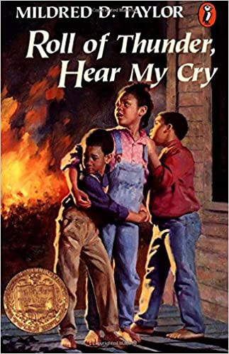
Story plot timelines
By: Mrs. Goodrich and
Mrs. Faour’s
Classes

Slide 2
Story Overview
This novel takes place in the 1930’s where racism and segregation was rampant in the south.
The Logan family was one of the few black families who owned their own farmland.
They worked hard to keep their land in their names and faced harsh cruelty for it.
Cassie Logan, the main character, was hit with prejudice and racial injustices throughout her life.
As the story unfolds, the Logan family demonstrates bravery and commitment to do what is right for the sake of their family and their land.

Slide 3
Student Requirements
After reading the novel, during the remote learning process, 5th graders were asked to identify the events in the novel that were a turning point or held value to the novel’s overall meaning.
Through weekly Discussion Posts and weekly Teams meetings, students discussed their views and opinions about the novel.
Students identified the racial injustices the main characters faced and how these incidents had an impact on the characters, as a whole.
The following slides are samples of the work that students were asked to do once they finished the novel.
Their work represents the incidents or circumstances throughout the novel which had a large impact on the family.

Slide 4
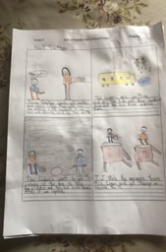
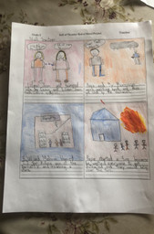
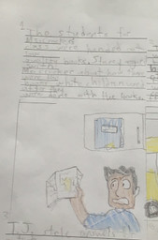
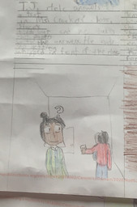
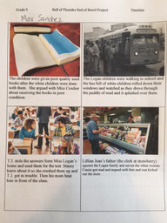
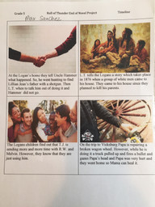
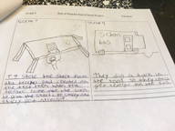
Student Work Samples

Slide 5
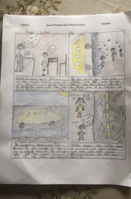
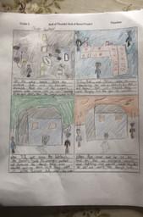
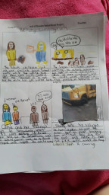
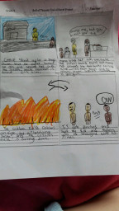
Additional Student Work…

Slide 6
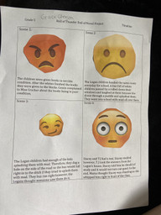
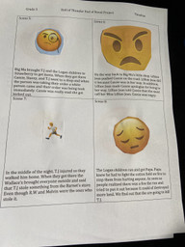
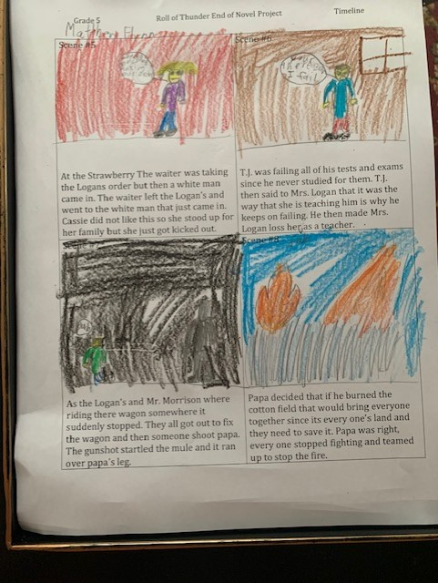
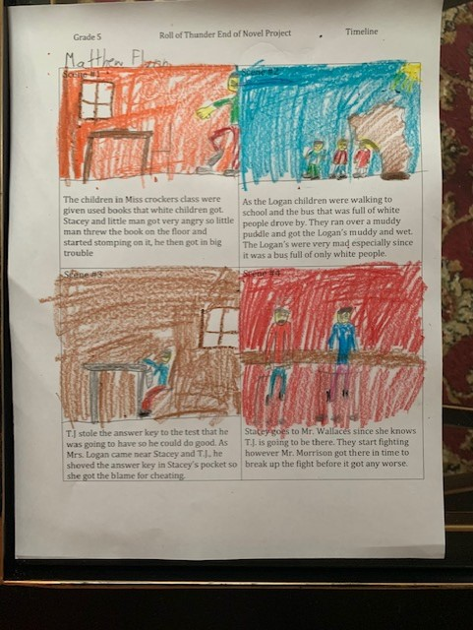
…

Slide 7
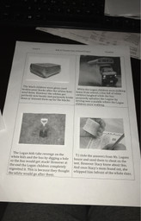
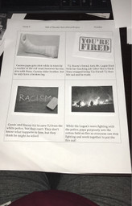
…

Slide 8
Student Created Slideshow

